Slide 1
Anatomy of candlestick
Pukar Sharma

Slide 2
Overview
What is Candlestick ?
Long Body Bullish and Bearish Candlestick
Short Body Candlestick
Pin Bar Candlestick

Slide 3
Candlestick
Candlestick display the four crucial price points [ Open, Close, High and Low] on a specific timeframe chosen by the trader.
It reveals the emotional state of the market, which often drives trading decisions

Slide 4
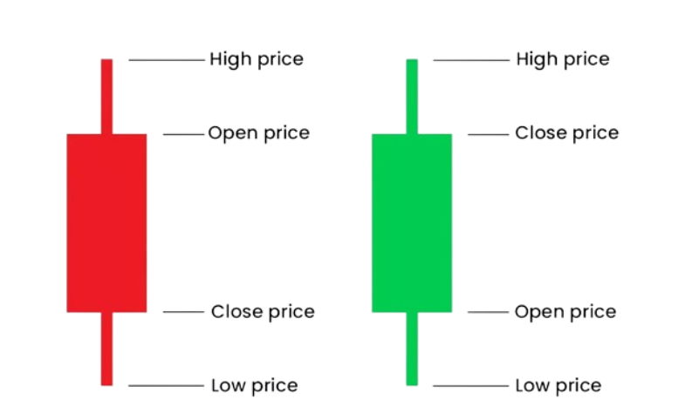

Slide 5
Long body bullish candle
This is also a good bullish long body candle but its has some selling and buying
A long green body forms when there is the wide range between open and close of the price .
Strong candles are the ones where the open is near low and close is new the high .
When we get these kind of candle then we have to put those stock in our watchlist
Close = High
Very strong
Open = low

Slide 6
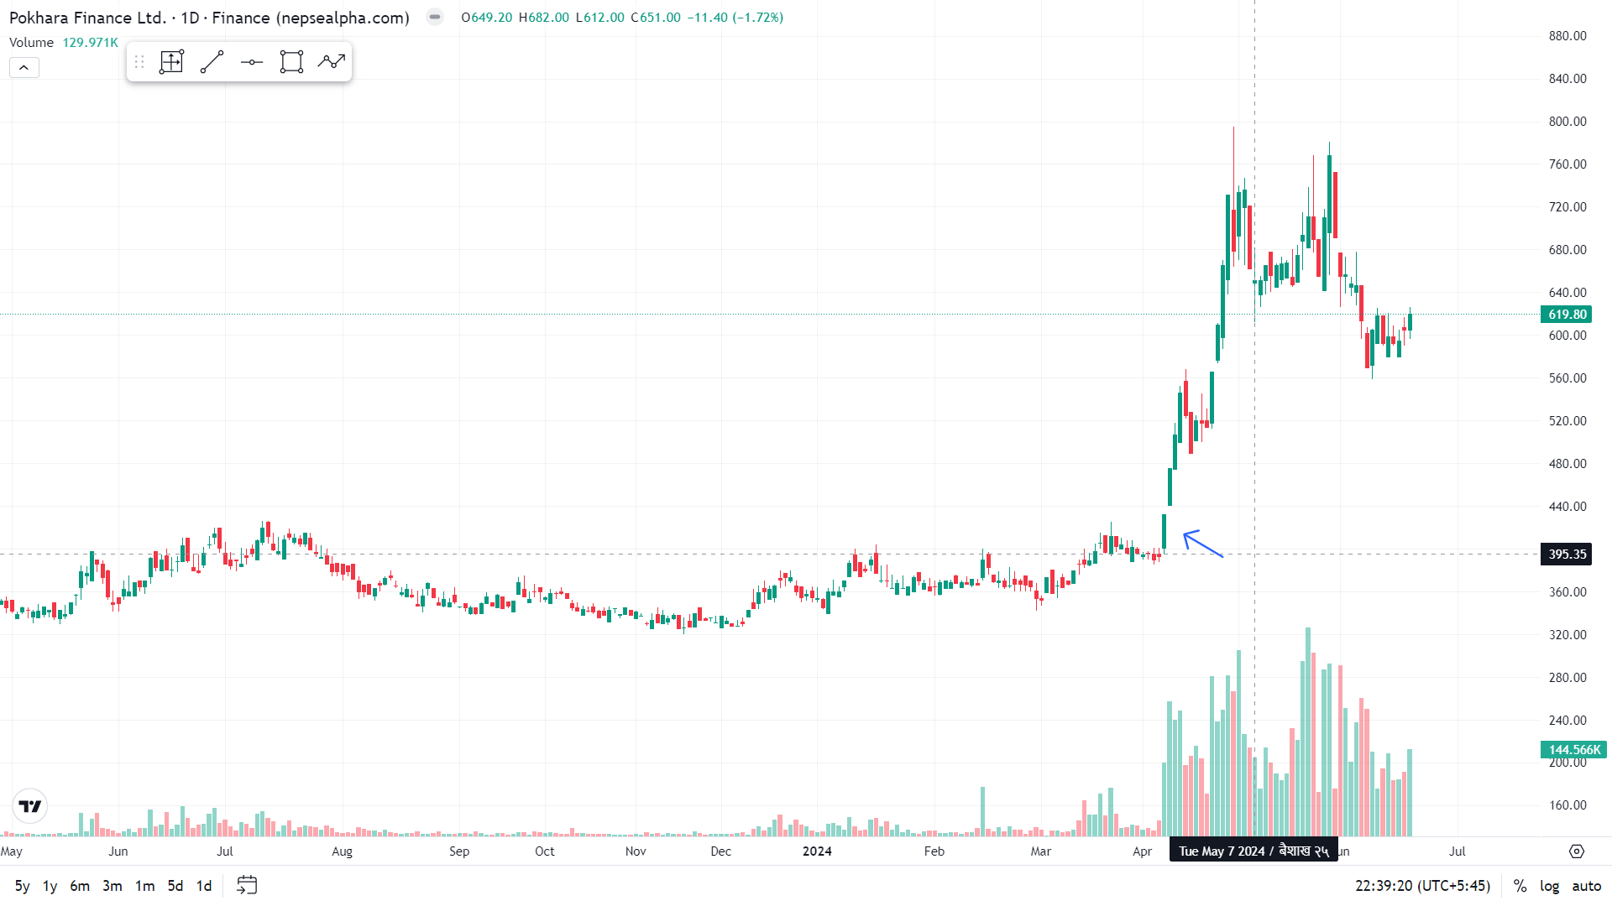
When we get this type of candle we have to put this stock in our watchlist

Slide 7
Long body bearish candle
This is also a good bearish long body candle but its has some buying but not strong
A long red body forms when there is the wide range between open and close of the price .
Strong Bearish candles are the ones where the open is near high and close is new the low .
When we get these kind of candle then we have to put those stock in our watchlist
Open = High
Very strong
Close = low

Slide 8
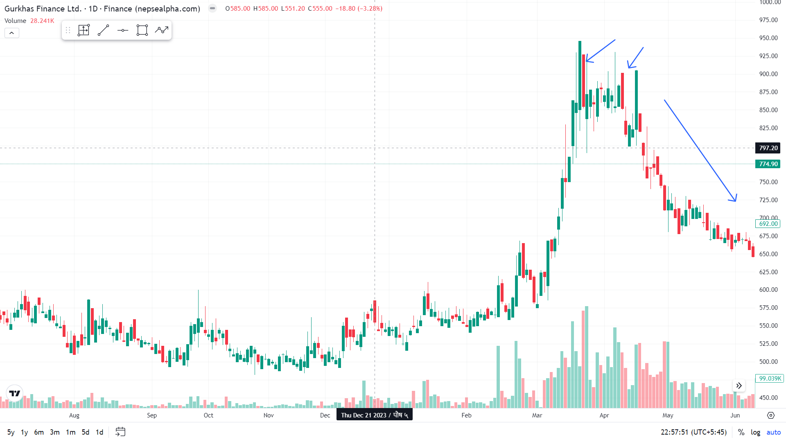
When we get this type of candle we have to put this stock in our watchlist

Slide 9
Bullish Engulf candle
Due to sudden event the buyer show their presence
When the previous day's price, represented by a red candlestick, is suddenly covered or engulfed by wide-range bullish candles, it produces a bullish engulfing.
It has a potential of reversal.
Something is changed.
Change in Sentiment due to Good news ( good EPS, Quartey Report, Bonus)
It can cause to correction or trend change

Slide 10
bearish Engulf candle
When the previous day's price, represented by a green candlestick, is suddenly covered or engulfed by wide-range bearish candles, it produces a bearish engulfing.
It has a potential of reversal.
Something is changed.
Change in Sentiment due to Bad news ( bad EPS, Quartey Report, Bonus)
It can cause to correction or trend change
Due to sudden event the seller show their presence

Slide 11
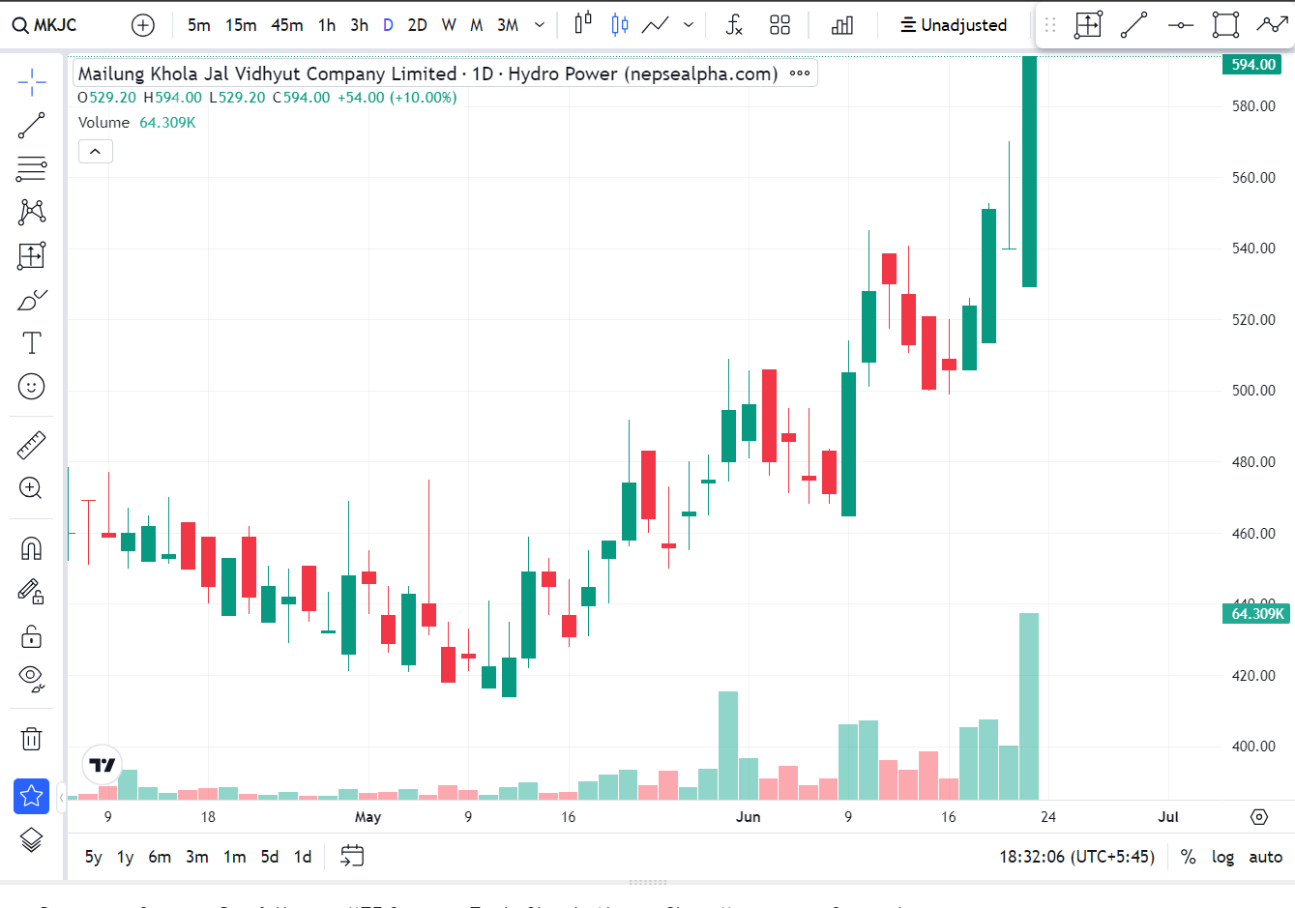
Indecisive Candles
Those candlestick which occurrence can change the trend or give a correction.
The Smart money is making decision about to extend this trend or take rest ( Correction or trend change)
This candlestick have a very small body, somethings they don’t have body ( Open = Close )
This types of Candlestick needs lots of confirmations.
No sign of Momentum
Smart money is making decision to buy it further

Slide 12
Pin bar Candles
Those candlestick having a long wick present are bin bar candles.
Their wick size is double as compare to body.
These candles are very powerful candles and give more conviction for decision making.
They are commonly called as hammer, hanging man, inverted hammer, etc.
This candlestick also signify the last seller and last buyer

Slide 13
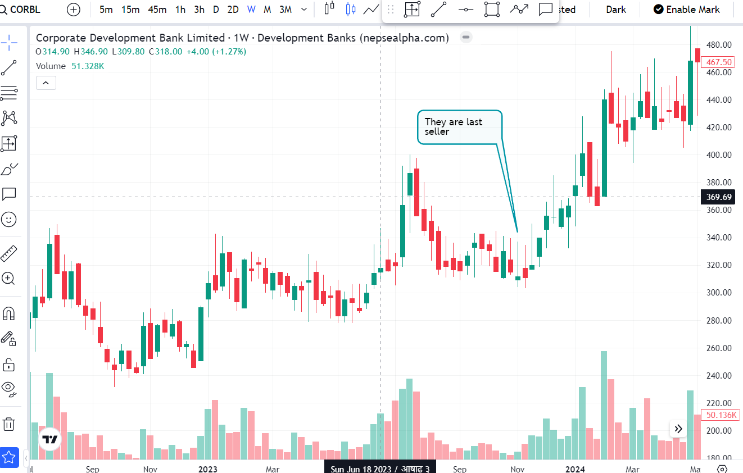
Inverted hammer gives some correction
hammer

Slide 14
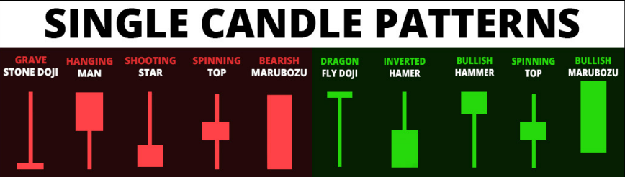
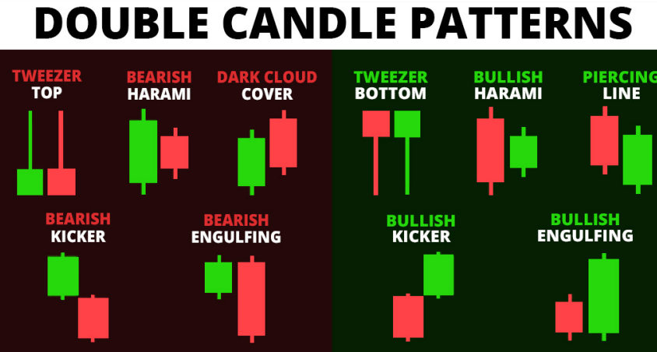

Slide 15
Assignments
What is volume ?
Who are Market Maker ?

Slide 16

THANK YOU
Pukar Sharma
sharmapukar98@gmail.com

